Slide 1
Thymeleaf Introduction

Slide 2
Agenda
Type of web pages
Difference in static and dynamic web pages
Thymeleaf introduction and need
Advantages of thymeleaf over JSP
Features of Thymeleaf
Setup, configuration and integration with Spring Boot
Creating Web Pages using Thymeleaf
Adding JavaScript in Thymeleaf web pages
Adding CSS in Thymeleaf web pages
Creating Registration form using Thymeleaf th:tags
Splitting common layout or default header / footer
Some basic iteration tags/loops for rendering dynamic data
Enums handling
Ajax Calls in Thymeleaf pages

Slide 3
Type of Web Pages
Static Web Pages
Dynamic Web Pages

Slide 4
Different type of web pages:
Web pages can be either static or dynamic.
"Static" means unchanged or constant. Example: Same of each visitor of website.
Standard HTML pages are static Web pages. They contain HTML code, which defines the structure and content of the Web page
"Dynamic" means changing or lively. Example: User specific pages. User profile pages for each user.
These pages contain "server-side" code, which allows the server to generate unique content each time the page is loaded.

Slide 5
What is Thymeleaf
Thymeleaf is a templating engine, it’s used to generate a visual representation of data, like user interfaces, emails or HTML reports.
The nice thing about Thymeleaf is that it’s HTML5, with some added syntactic sugar for data merging.

Slide 6
Advantages of Thymeleaf over JSP
https://www.dineshonjava.com/thymeleaf-vs-jsp-spring-mvc-view-layer/#.WEkLzLKLTig
This looks much more HTML-ish than the JSP version – no strange tags, just some meaningful attributes.
Variable expressions (${…}) are Spring EL and execute on model attributes, asterisk expressions (*{…}) execute on the form backing bean, hash expressions (#{…}) are for internationalization and link expressions (@{…}) rewrite URLs. (If you want to know more about this, have a look at the “Getting started with the Standard Dialect in 5 minutes” guide).
We are allowed to have prototype code there: for example, we can set an Email: text in the label for the first field, knowing that Thymeleaf will substitute it with the internationalized text with key subscription.email when it executes the page.
We have even been able to add anfor a second radiobutton just for prototyping pleasure. It will be removed when Thymeleaf executes our page.

Slide 7
Some features of thymeleaf
Some of the features that are available when using Thymeleaf in a Spring application are:
support for defining forms behavior
binding form inputs to data models
validation for form inputs
displaying values from message sources
rendering template fragments

Slide 8
Standard Expression Syntax
Most Thymeleaf attributes allow their values to be set as or containing expressions, which we will call Standard Expressionsbecause of the dialects they are used in. These can be of five types:
${...} : Variable expressions.
*{...} : Selection expressions.
#{...} : Message (i18n) expressions.
@{...} : Link (URL) expressions.
~{...} : Fragment expressions.

Slide 9
Setup
Create a gradle java project
Add the spring boot gradle plugin in build.gradle file
buildscript {
repositories {
mavenCentral()
}
dependencies {
classpath("org.springframework.boot:spring-boot-gradle-plugin:2.0.5.RELEASE")
}
}
Apply plugin ‘org.springframework.boot’ for spring boot related tasks
apply plugin: 'org.springframework.boot'
Add the following dependencies to build.gradle file
compile group: 'org.springframework.boot', name: 'spring-boot-starter-web', version: '2.0.5.RELEASE'
compile group: 'org.springframework.boot', name: 'spring-boot-starter-thymeleaf', version: '2.0.5.RELEASE'

Slide 10
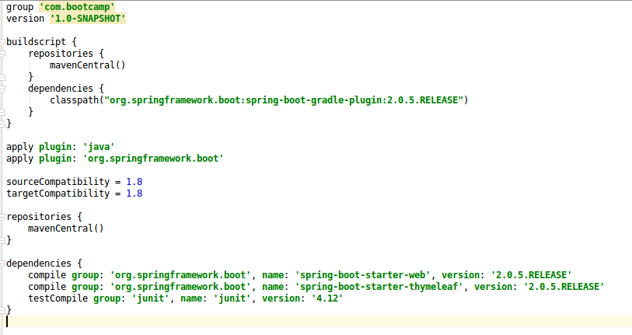
Setup (Contd.)

Slide 11
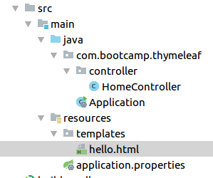
Creating a Simple Hello World Application
Create the following folder structure:

Slide 12
Creating a Simple Hello World Application (Contd.)
Create hello.html file inside src/main/resources/templates directory
<!DOCTYPE html>
<html xmlns:th="http://www.thymeleaf.org">
<head>
<meta charset="UTF-8">
<title>Hello Thymeleaf</title>
</head>
<body>
Hello Thymeleaf!
</body>
</html>

Slide 13
Creating a Simple Hello World Application (Contd.)
Create the controller
@RequestMapping("/")
@Controller
public class HomeController {
@GetMapping("sayHello")
public String sayHello() {
return "hello";
}
}
Run the application using ‘gradle bootrun’ and visit URL http://localhost:8080/sayHello

Slide 14
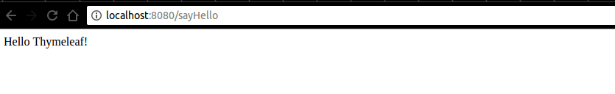
Demo Hello World

Slide 15
Adding Javascript in HTML
To add JavaScript in HTML. Use tag:
<script th:src="@{'/javascripts/application.js'}"></script>

Slide 16
Adding CSS in HTML
To add CSS in HTML. Use tag:
<link th:href="@{'/stylesheets/application.css'}" rel="stylesheet"/>

Slide 17
Create User Registration form
Hands-on
Let’s create a registration form using th:tags

Slide 18
If condition examples
<div th:if="${true}">
Should be display.2
</div>
<div th:if="${false}">
Should not be display.2
</div>

Slide 19
Unless condition examples
<body th:with="var=${false}">
<span th:if="${var}">if</span>
<span th:unless="${var}">unless</span>
</body>

Slide 20
Thymeleaf Truth
If value is not null:
If value is a boolean and is true.
If value is a number and is non-zero
If value is a character and is non-zero
If value is a String and is not “false”, “off” or “no”
If value is not a boolean, a number, a character or a String.
(If value is null, th:if will evaluate to false).

Slide 21
For Loop examples
<body th:with="var=${({1, 2, 3})}">
<table>
<tr th:each="i : ${var}">
<td th:text="${i}">.</td>
</tr>
</table>
</body>
Status variables are defined within a th:each attribute and contain the following data:
The current iteration index, starting with 0. This is the index property.
The current iteration index, starting with 1. This is the count property.
The total amount of elements in the iterated variable. This is the size property.
The iter variable for each iteration. This is the current property.
Whether the current iteration is even or odd. These are the even/odd boolean properties.
Whether the current iteration is the first one. This is the first boolean property.
Whether the current iteration is the last one. This is the last boolean property.
<body th:with="var=${({1, 2, 3})}">
<table>
<tr th:each="prod, iterStat : ${var}" class="row" th:classappend="${iterStat.odd}? 'odd'">
<td th:text="${prod}">.</td>
</tr>
</table>
</body>

Slide 22
Iterating User Object
List<User> users = populateUsers();
model.addAttribute("users", users);
return "usersPage";
<table>
<tr>
<td>Id</td>
<td>Name</td>
<td>Sex</td>
<td>Salary</td>
<td>Admin</td>
</tr>
<tr th:each="user : ${users}">
<td th:text="${user.id}"></td>
<td th:text="${user.name}"></td>
<td th:text="${user.sex}"></td>
<td th:text="${user.salary}"></td>
<td th:text="${user.admin}"></td>
</tr>
</table>

Slide 23
ENUM
public enum Competency {
JVM("JVM"),
MEAN("MEAN"),
DEVOPS("DevOps"),
QA("QA");
String value;
Competency(String competency) {
value = competency;
}
public String getValue() {
return value;
}
}
<label>Competency: </label>
<select>
<option th:value="None">Select One</option>
<option th:each="competency : ${T(com.bootcamp.thymeleaf.enums.Competency).values()}"
th:value="${competency.getValue()}" th:text="${competency.getValue()}"></option>
</select>

Slide 24
Common layout
To use the common layout across the website.
Step : 1 Create a layout with a name
Step : 2 Call it by name in other pages.
<head th:fragment="head">
<link th:href="@{'/stylesheets/application.css'}" rel="stylesheet"/>
</head>
<div th:fragment="common-js">
<script th:src="@{'/javascripts/application.js'}"></script>
</div>

Slide 25
Ajax Calls
<button id="populateUsersId" name="populateUsers">Populate Users?</button>
<ul id="userUlId"></ul>
$(document).on('click', '#populateUsersId', function () {
populateUsers();
});
var populateUsers = function () {
var users = $.ajax({
url: "/list/users",
method: "GET"
});
users.done(function (data) {
if (data) {
data.forEach(function (user) {
$('#userUlId').append("<li>" + user.name + "</li>");
});
}
});
users.fail(function (jqXHR, textStatus) {
console.log("Error in fetching users");
})
};

Slide 26
Thank you

